Slide 2
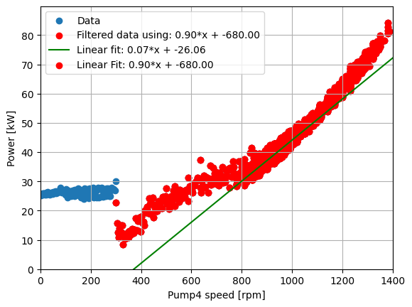
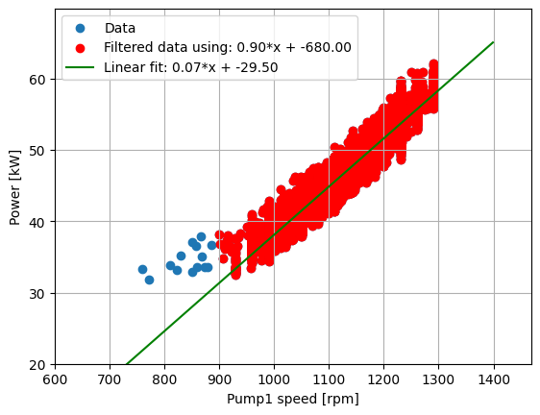

Static models
Power vs. Pump 4
Power vs. Pump 1

Slide 3
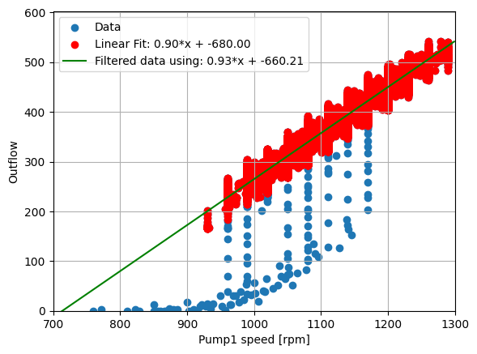
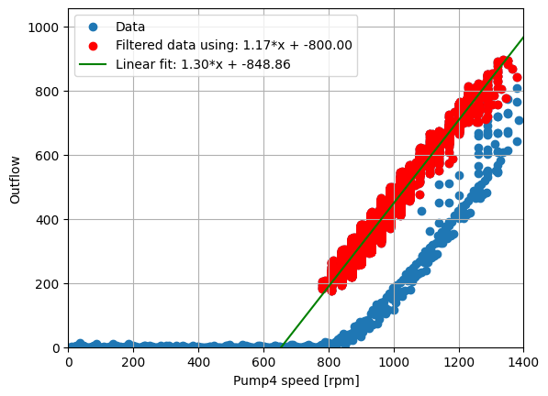
Static model

Slide 4
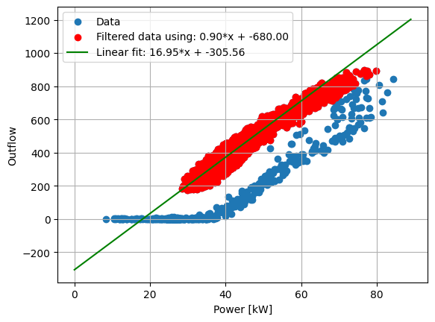
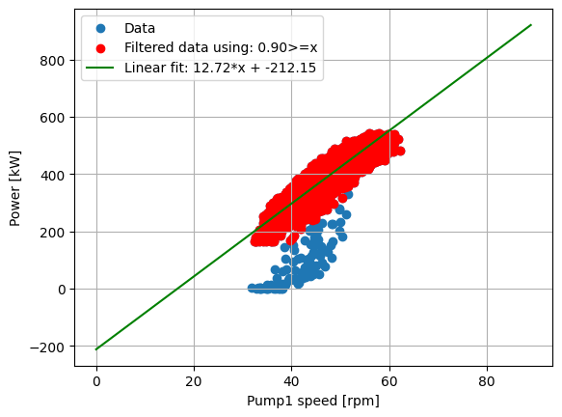
Static model

Slide 5
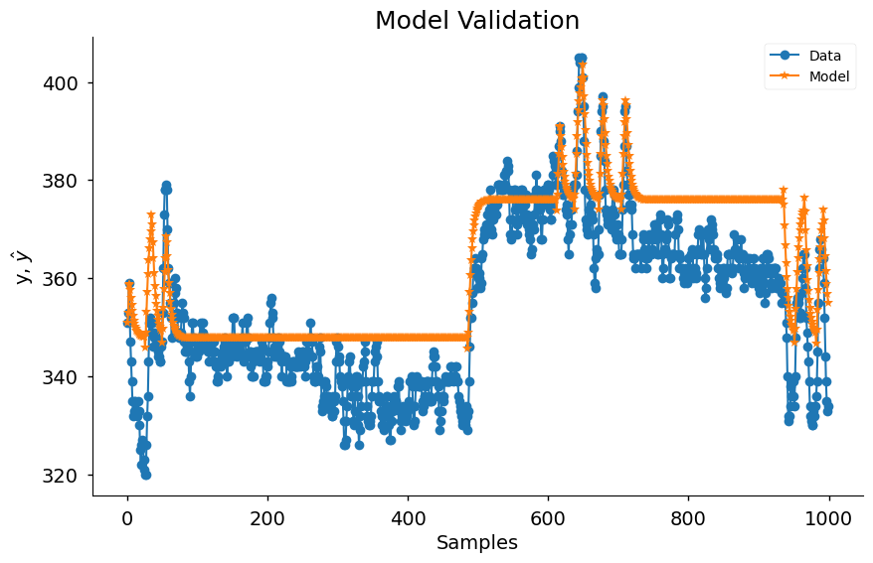
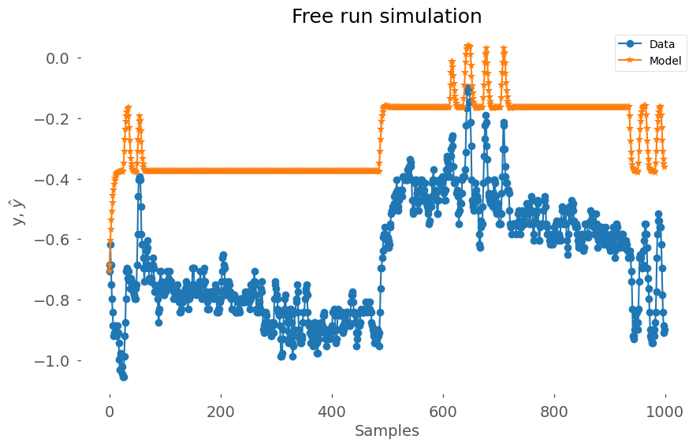
ARX
NN

Slide 6
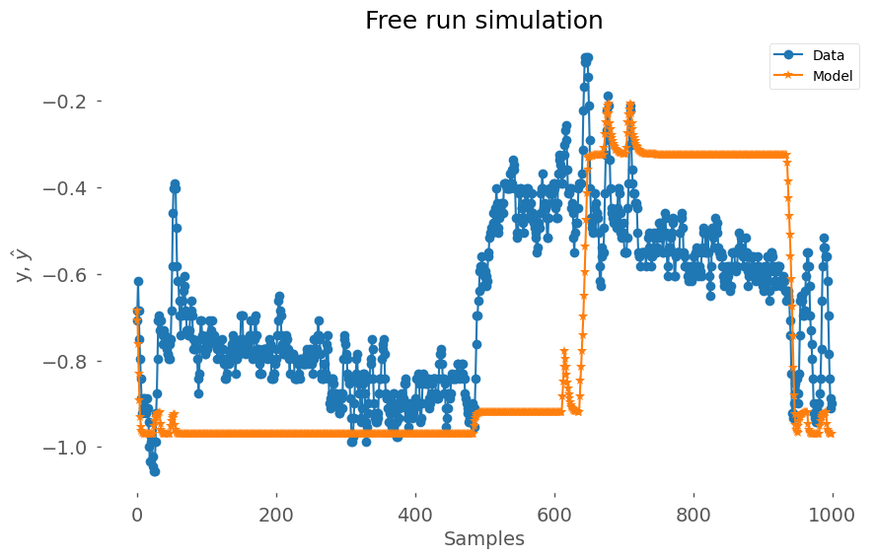
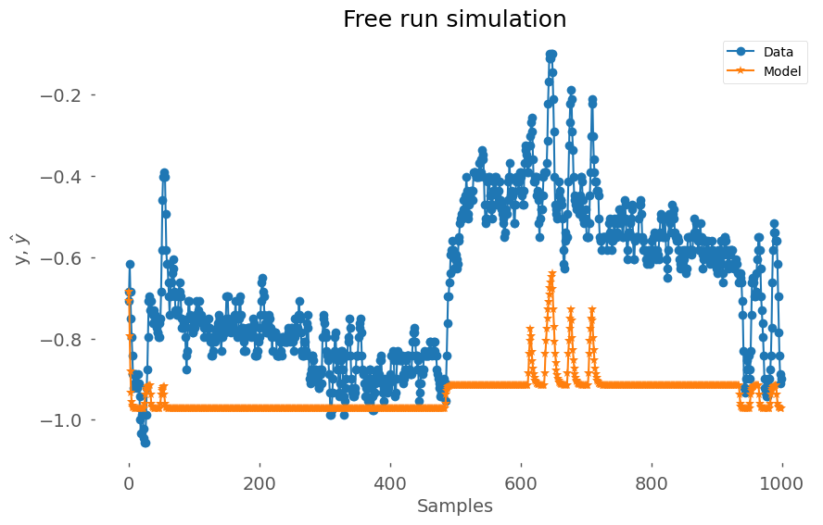
NN training parameters
5 epochs, MSE = 0.1506
3 epochs, MSE = 0.1183

Slide 7
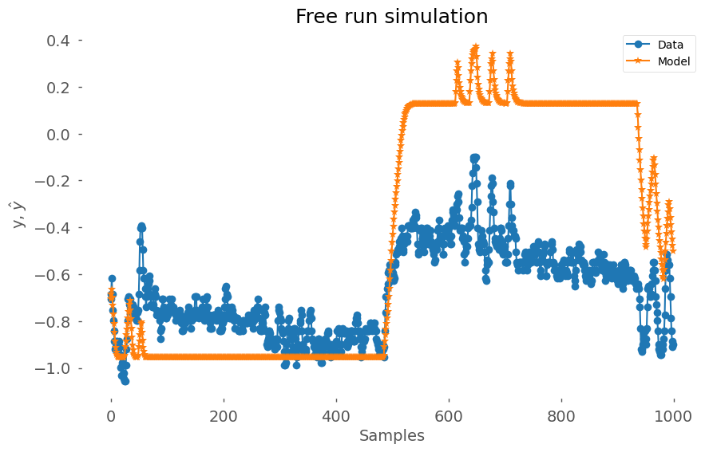
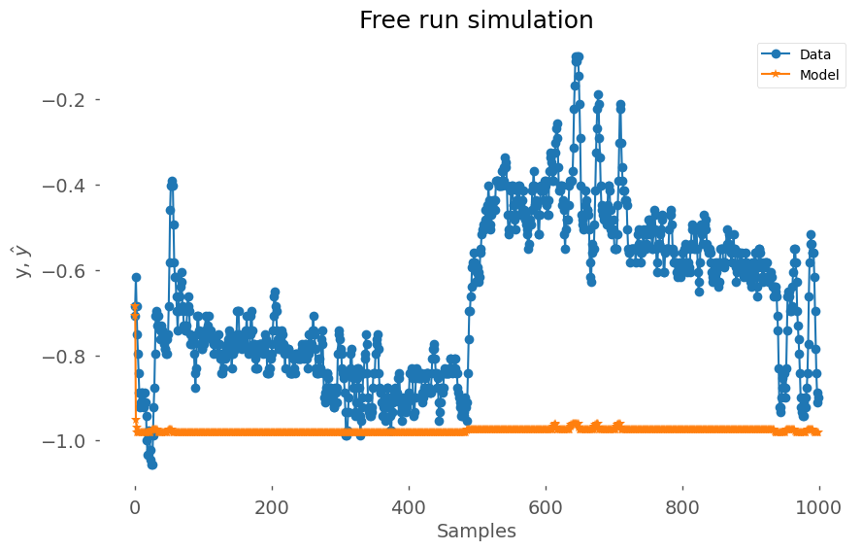
NN training parameters
10 epochs, MSE = 0.2536
1 epochs, MSE = 0.4071

Slide 8
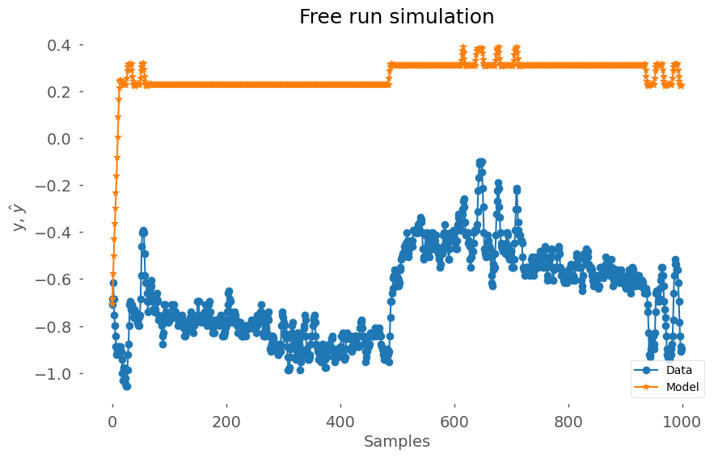
NN training parameters
20 epochs, MSE = 0.5001
3 epochs, MSE = , 2 HL x 4 neurons

Slide 9
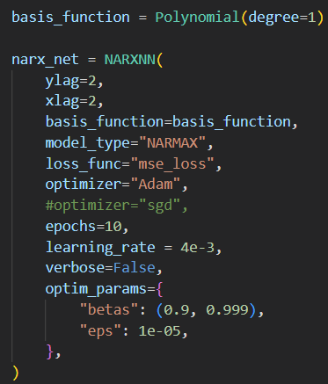
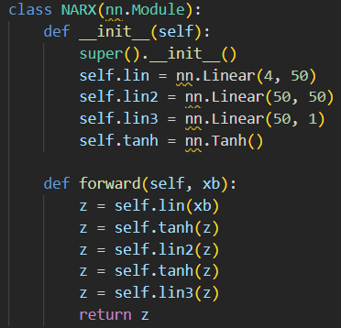
NN settings

Slide 10
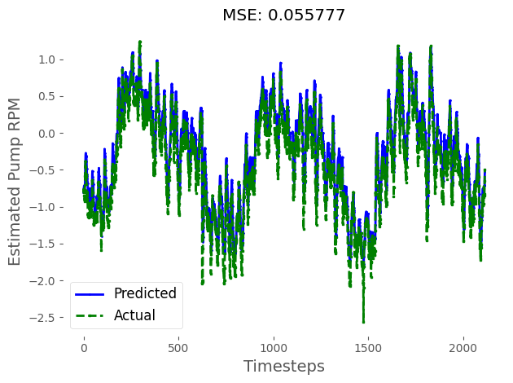
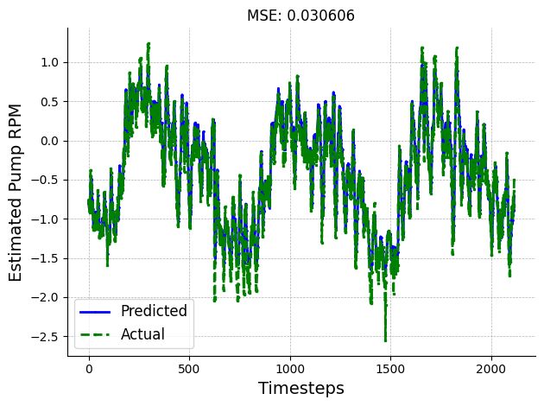
NN loss functions
Mse_loss
L1_loss

Slide 11

NN loss functions
Mse_loss (ReLU)
L1_loss

